Slide 1
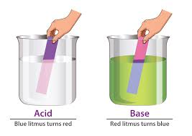
Acid-Base Titration

Slide 2
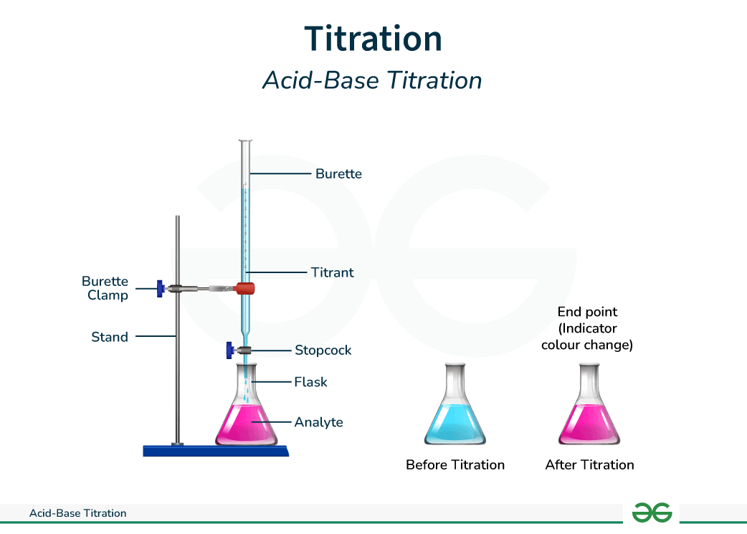
Introduction to Titration
What is titration ?
A laboratory technique used to determine the concentration of an unknown solution.
Types : 1. Acid Base Titration
2. Redox Titration etc

Slide 3
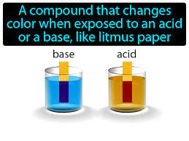
Explanation of Acid Base titration
Titrant : Solution of known concentration
Analyte: Solution of unknown concentration (acid or base)
Indicator: Substance that changes color at the equivalence point

Slide 4
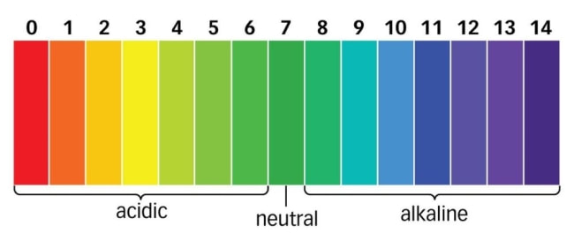
pH and Equivalence Point
pH scale : Measures acidity and basicity(0 – 14)
Equivalence Point : When moles of acid =moles of base
End Point :Close to the equivalence point,where the indicator chamges color

Slide 5
Conclusion and Applications
Summary: Titration helps determines the concentration of unknown solutions using known reactions .
Applications of Acid Base Titration:
Pharmaceutical industry
Environmental monitoring
Food industry

